Slide 1


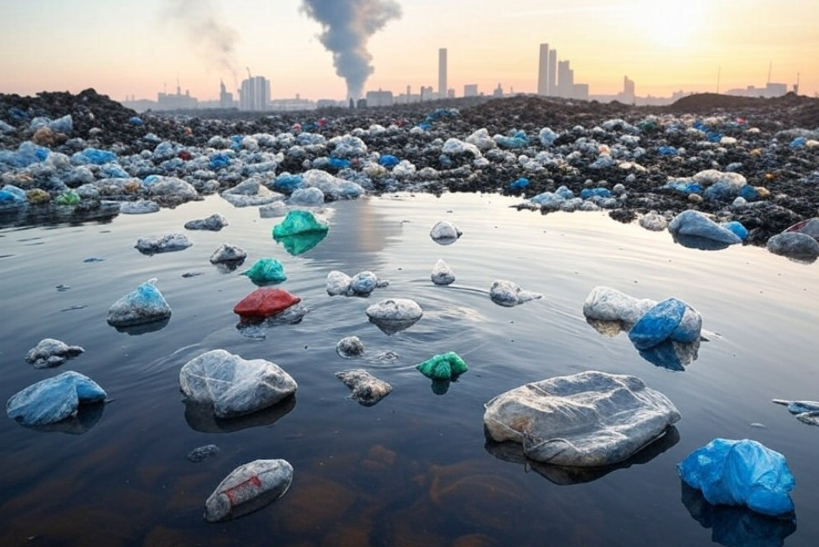
Pollution, Waste Management, and Recycling: Challenges and Solutions for a Sustainable Future

Slide 2

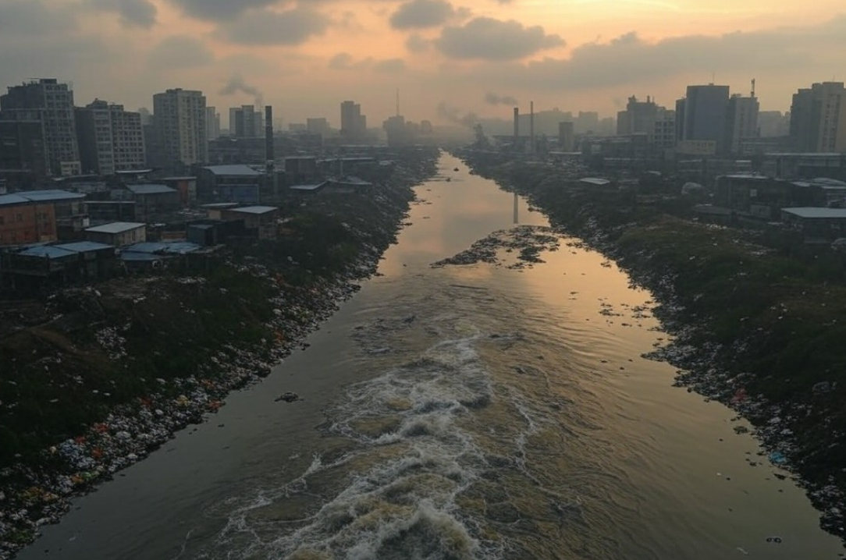
TOPIC 1: Pollution, a global crisis
Pollution is the contamination of the environment with harmful substances, posing significant threats to human health and ecosystems. This presentation explores the various types of pollution, their causes, effects, and ways to address this global issue.

Slide 3
Main Types of Pollution
Air Pollution
Water Pollution
Soil Pollution
Contamination of the air with harmful substances such as gases, particulate matter, and smoke.
Contamination of water bodies with harmful substances such as chemicals, sewage, and industrial waste.
Contamination of soil with harmful substances such as pesticides, fertilizers, and industrial waste.

Slide 4
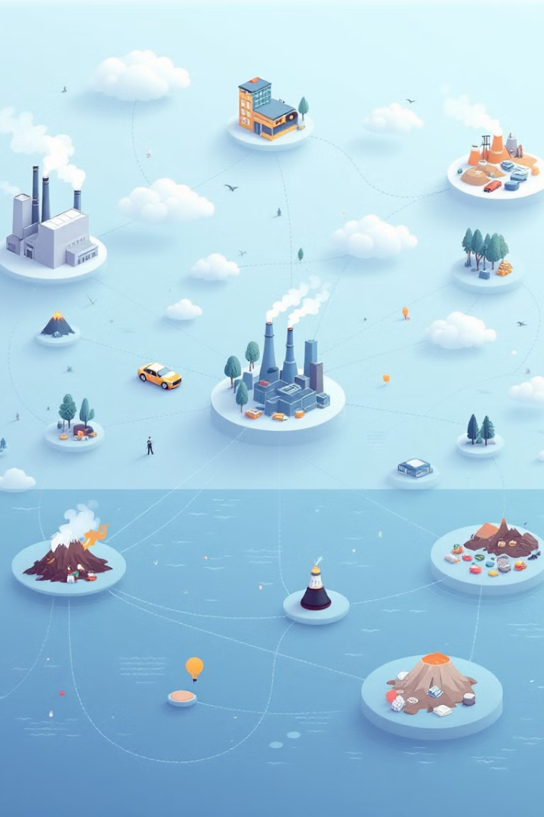
Causes of Pollution
Industrial Activities
Transportation
Emissions from factories and industries contribute significantly to air, water, and soil pollution.
Exhaust fumes from vehicles are a major source of air pollution, particularly in urban areas.
Agriculture
Waste Disposal
Pesticides, fertilizers, and animal waste contribute to soil and water pollution.
Improper waste management practices can lead to landfilling, incineration, and pollution of air, water, and soil.

Slide 5
Air Pollution: Causes and Effects
Causes
Effects
Fossil fuel combustion, industrial emissions, and vehicle exhaust fumes are major contributors to air pollution.
Air pollution can cause respiratory problems, cardiovascular diseases, and other health issues, affecting both humans and the environment.

Slide 6
Water Pollution: Sources and Consequences
Sources
Consequences
Industrial discharge, sewage treatment plant overflows, agricultural runoff, and oil spills are common sources of water pollution.
Water pollution can lead to waterborne diseases, damage aquatic ecosystems, and disrupt water supplies for drinking and agriculture.
Go Green Against Climate Change - 2023-1-RO01-KA220-SCH-000161283

Slide 7
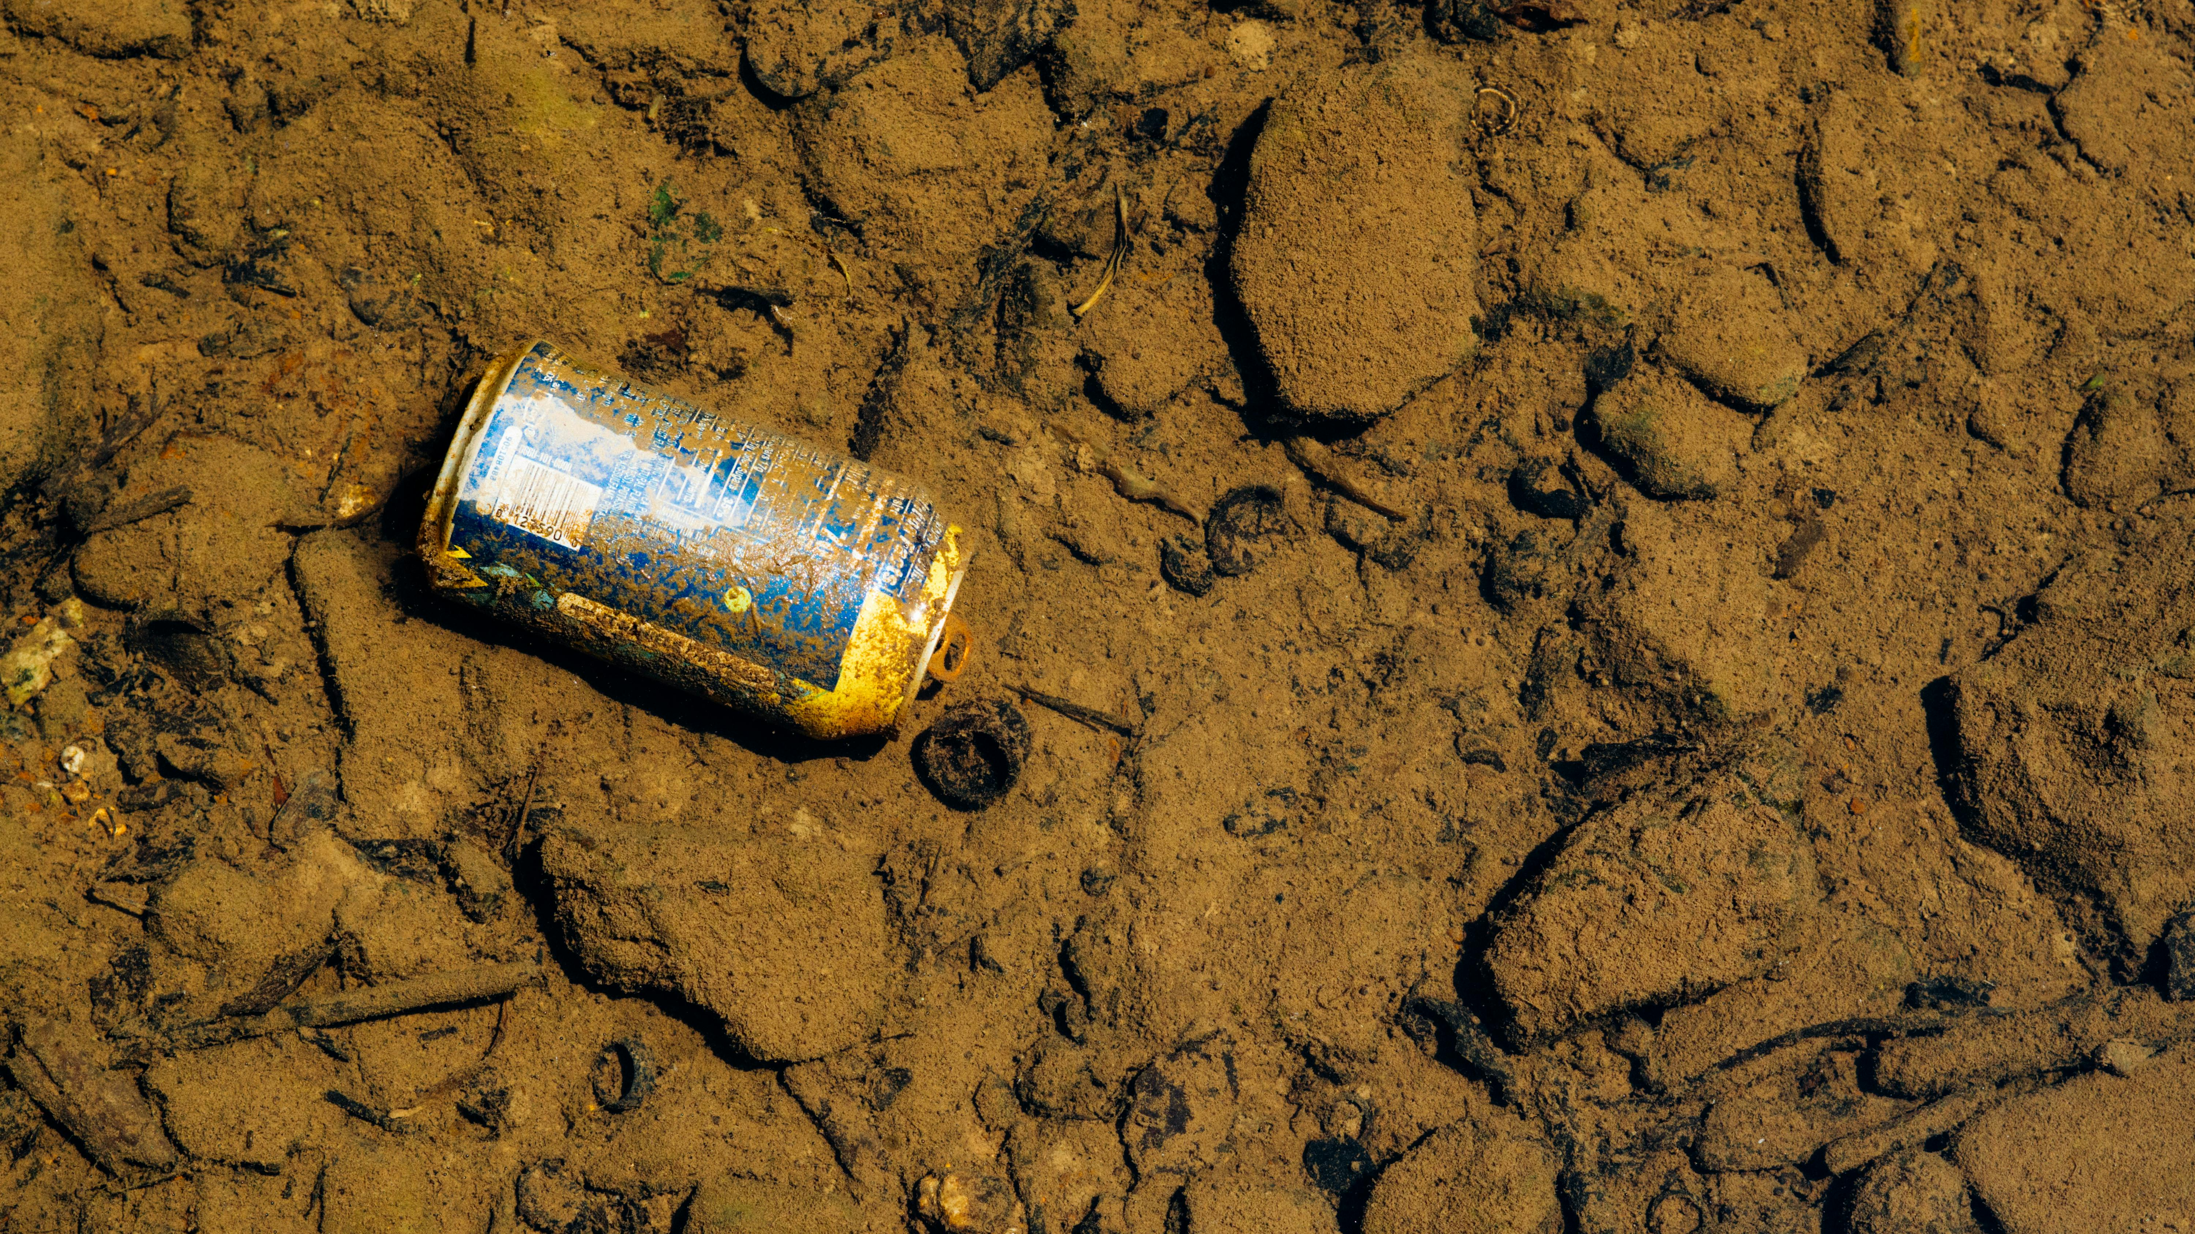
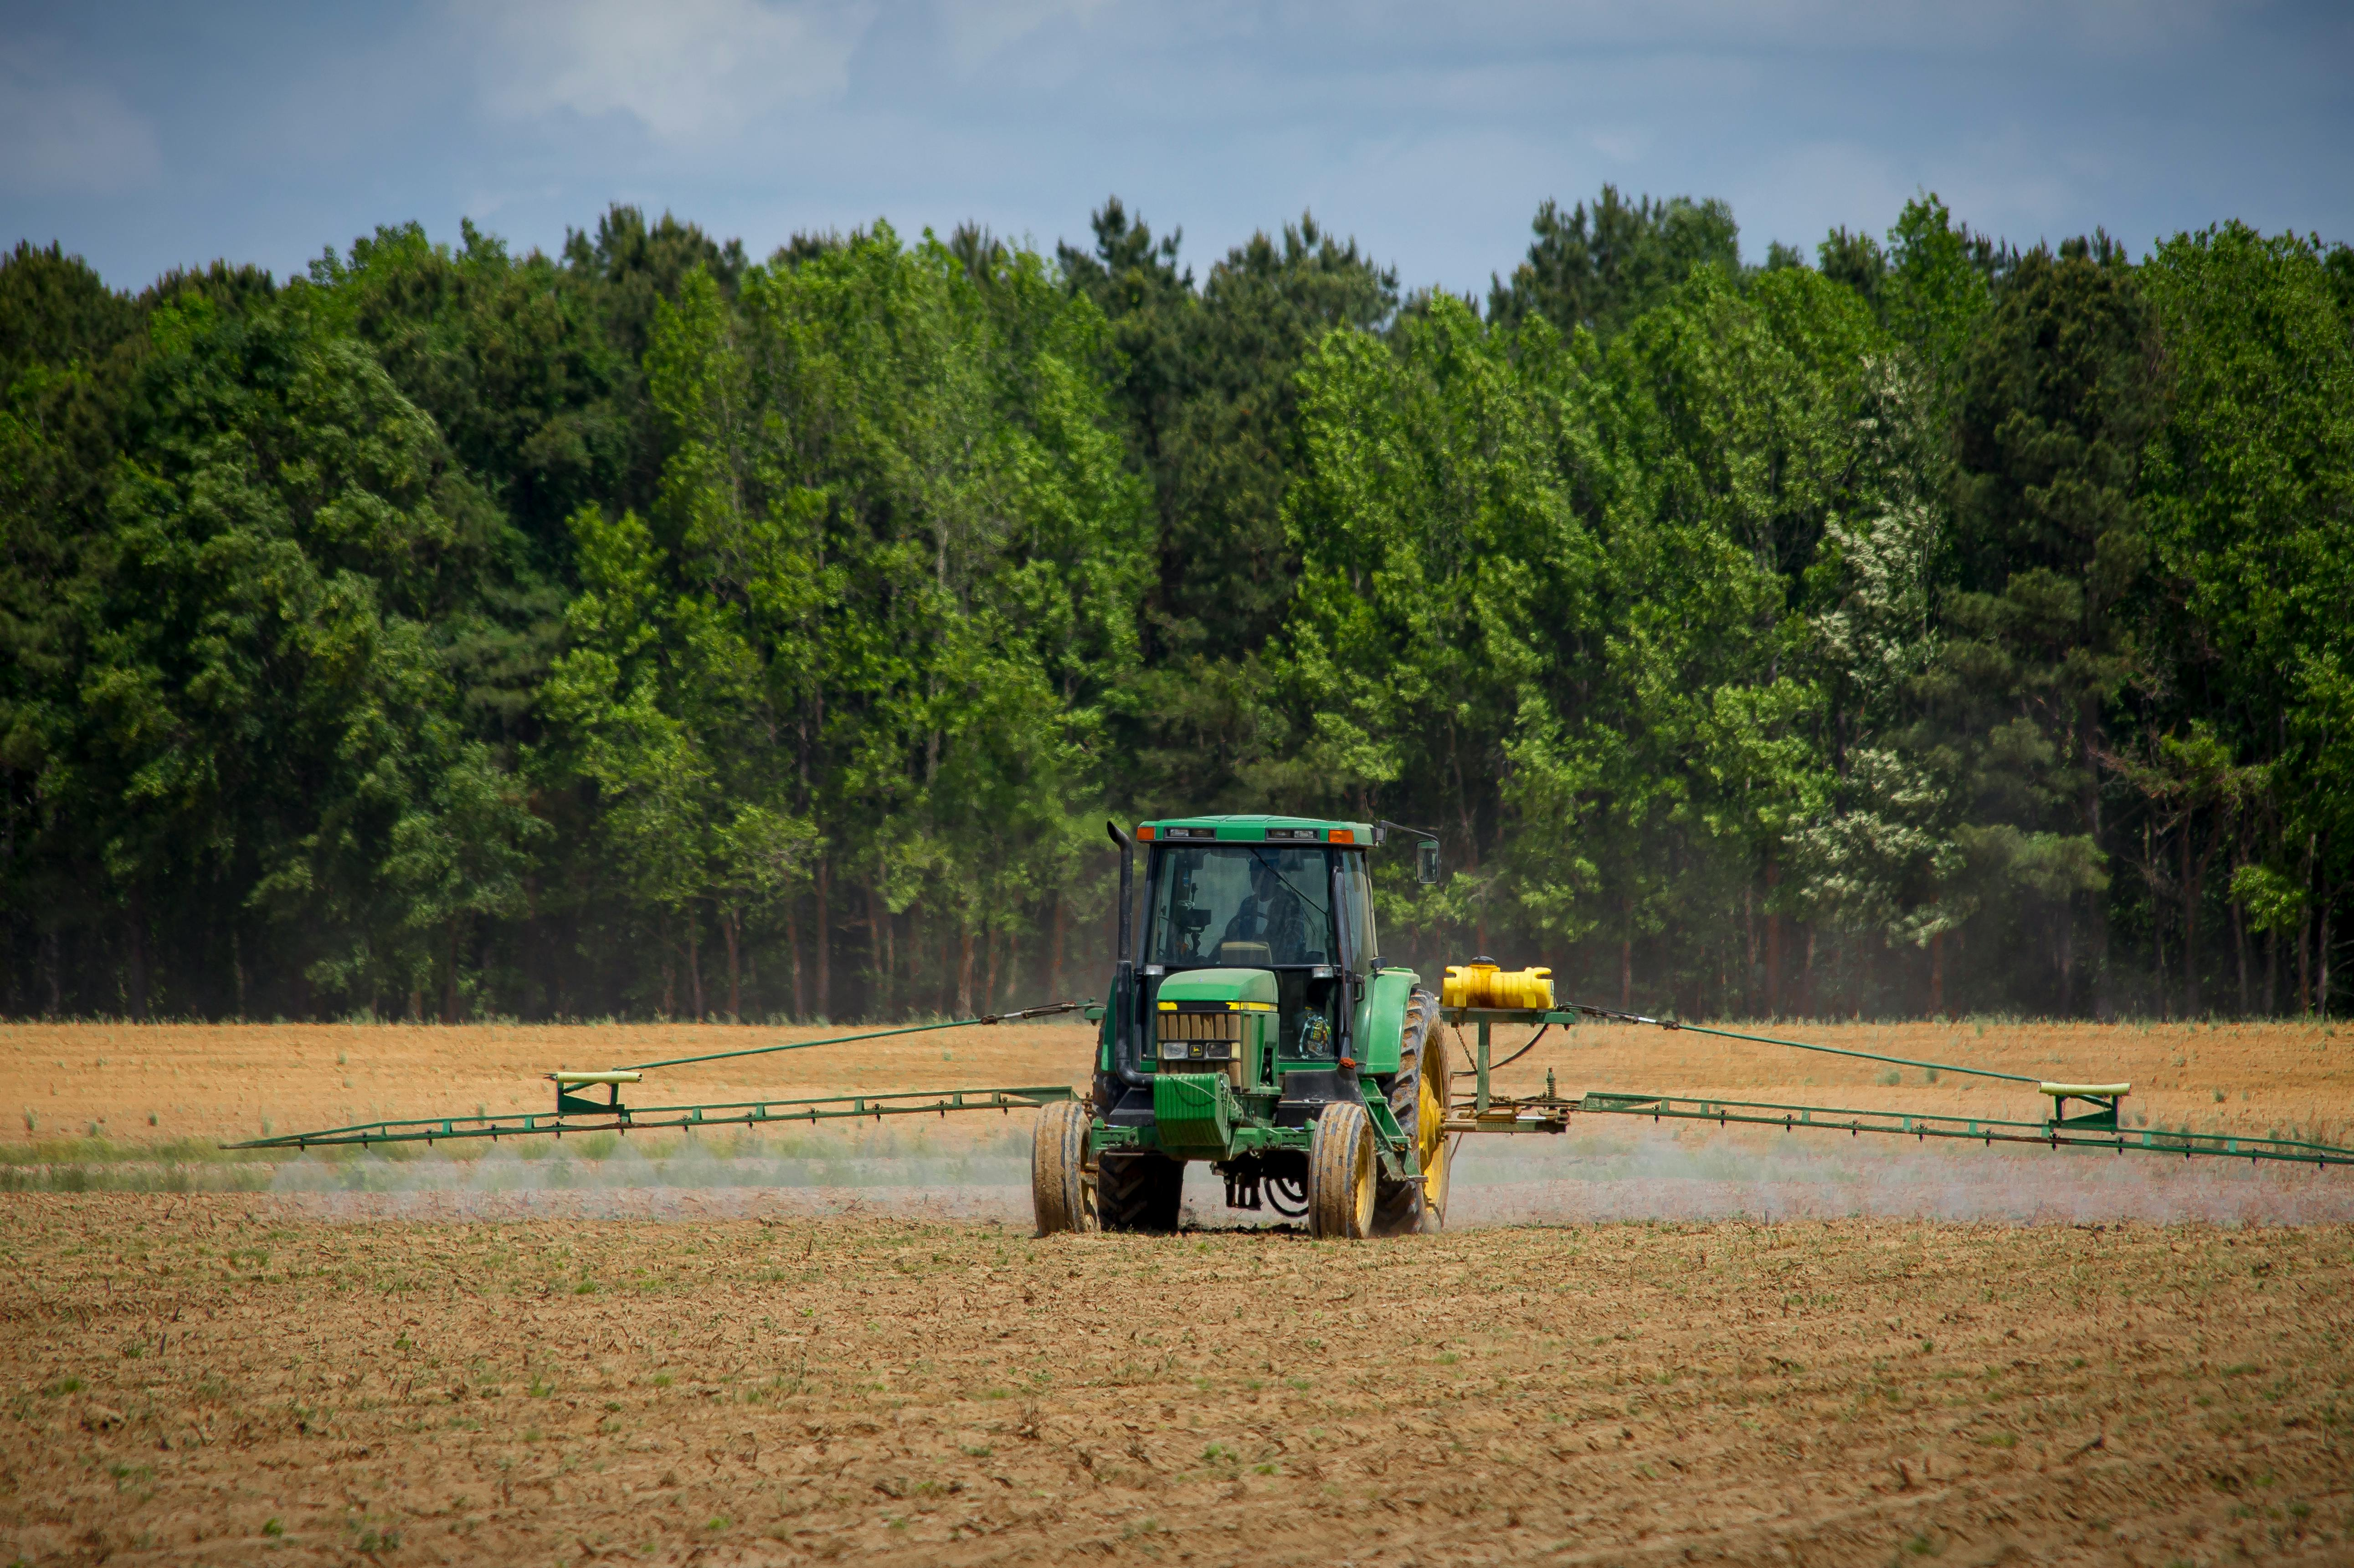
Soil Pollution: Impacts on Agriculture
Impacts
Agriculture
Soil pollution can reduce crop yields, contaminate food sources, and harm soil organisms essential for fertility.
Excessive use of pesticides, fertilizers, and unsustainable farming practices contribute to soil pollution.

Slide 8
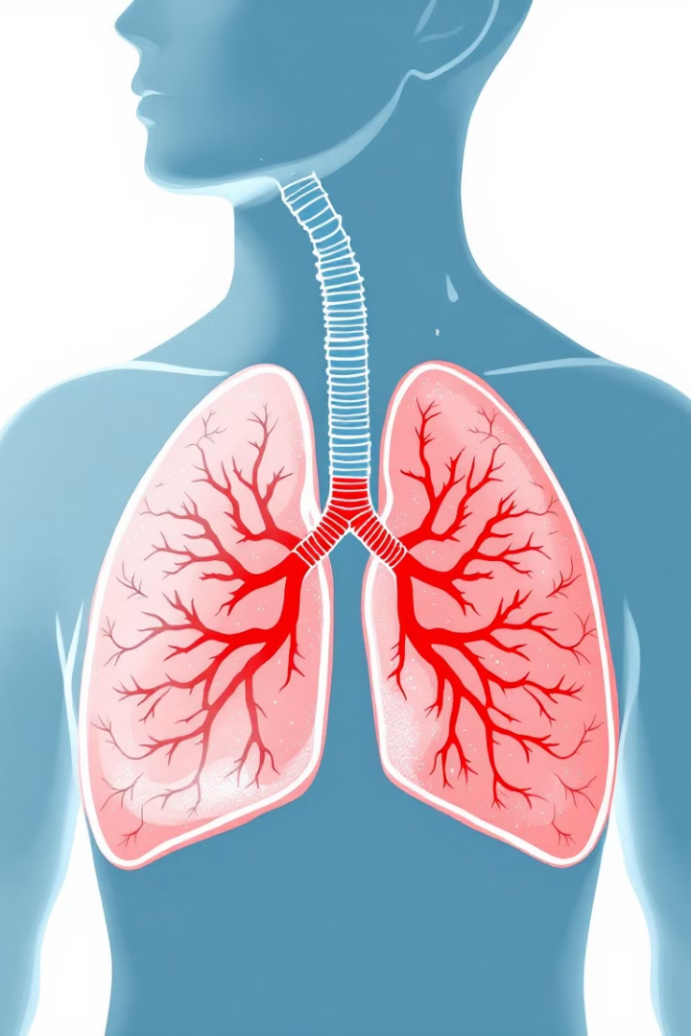
Health Effects of Pollution
Respiratory Problems
Cardiovascular Diseases
Air pollution can trigger asthma, bronchitis, and other respiratory illnesses.
Air pollution can increase the risk of heart attacks, strokes, and other cardiovascular diseases.
Cancer
Neurological Disorders
Exposure to certain pollutants, such as asbestos and benzene, can increase the risk of cancer.
Some pollutants can affect brain development and function, potentially leading to neurological disorders.

Slide 9
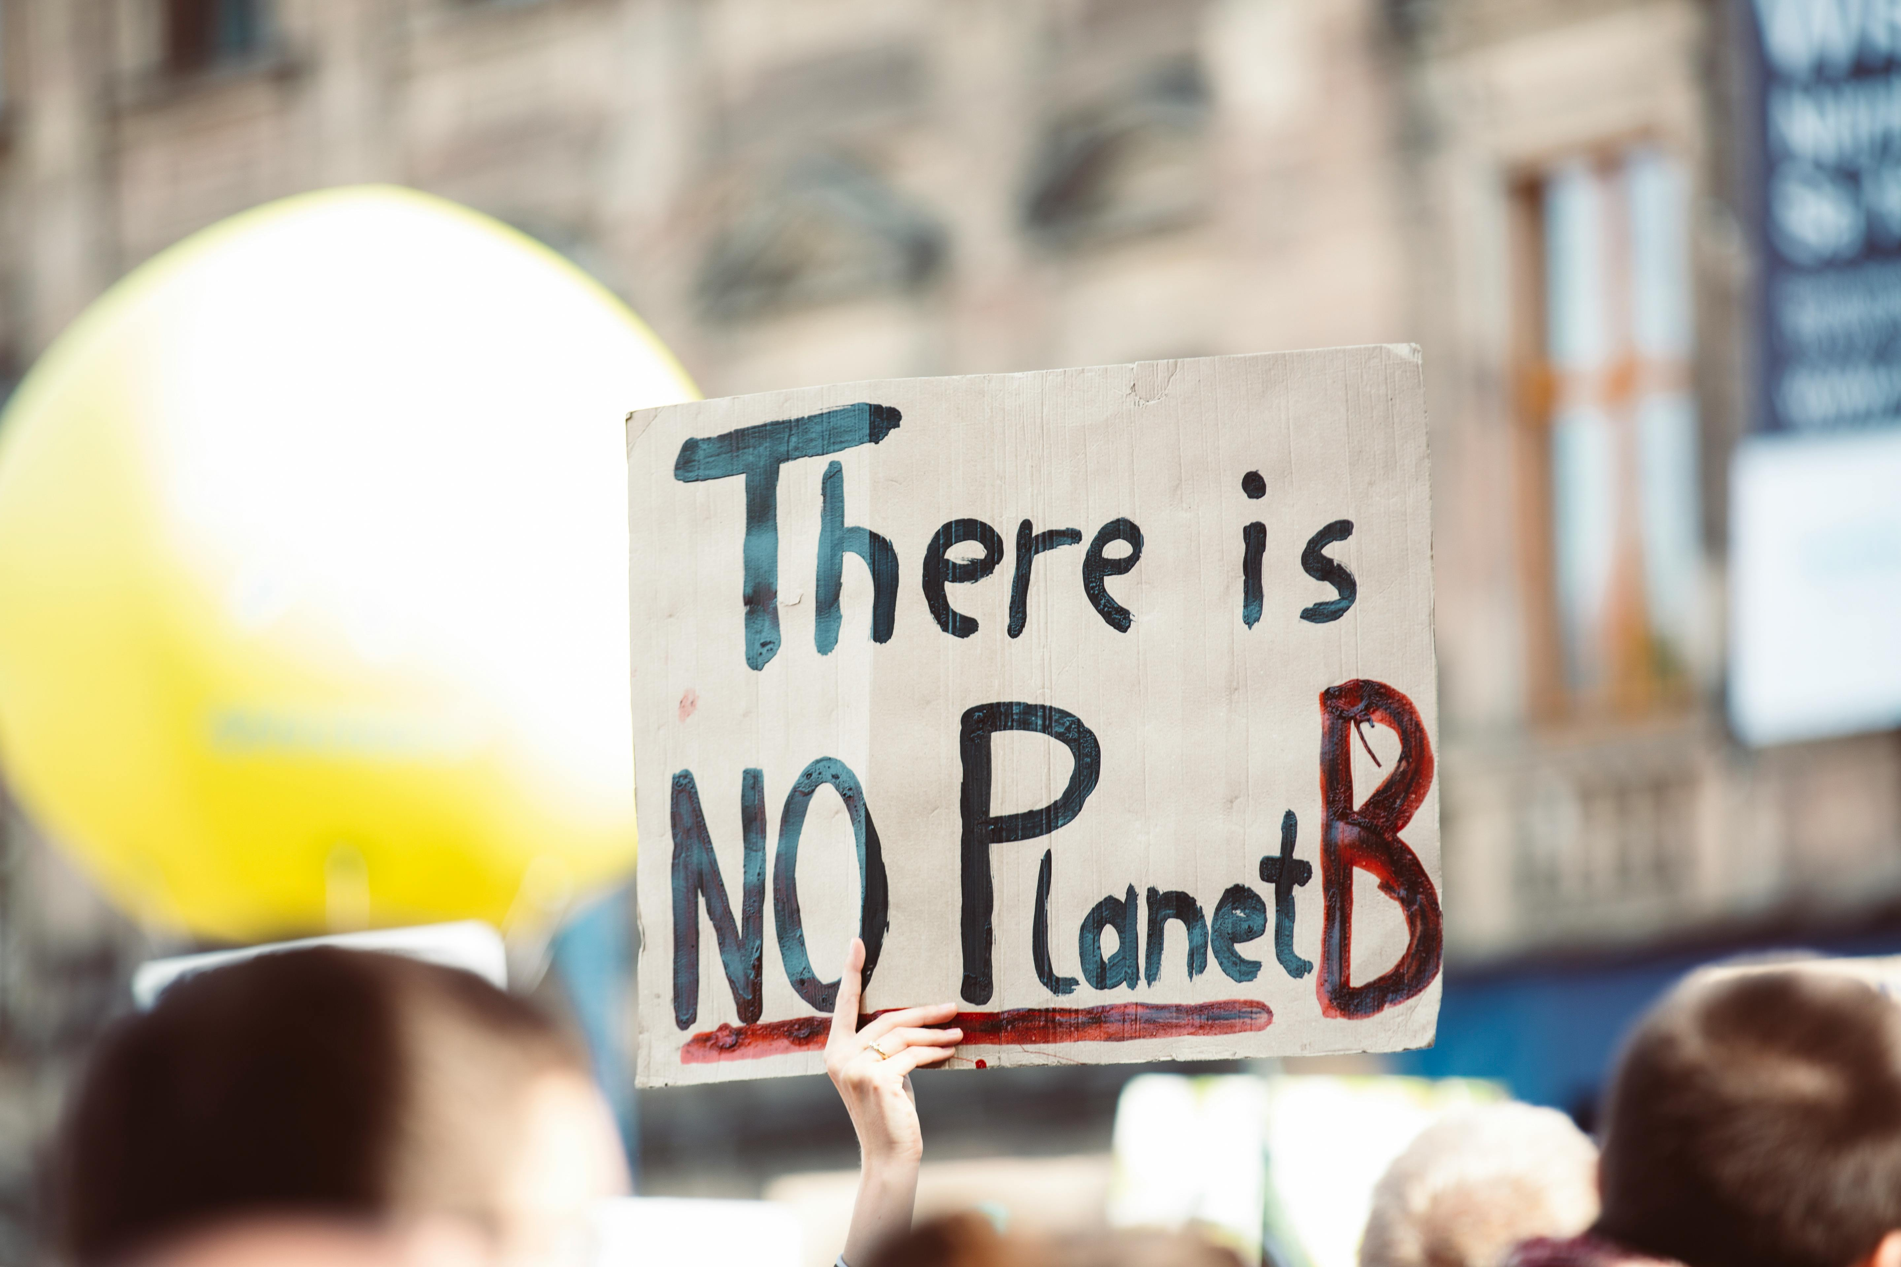
Environmental Consequences
Climate Change
Biodiversity Loss
Greenhouse gas emissions from pollution contribute to global warming and climate change, with significant environmental impacts.
Pollution can harm habitats, disrupt ecosystems, and lead to the extinction of species.

Slide 10
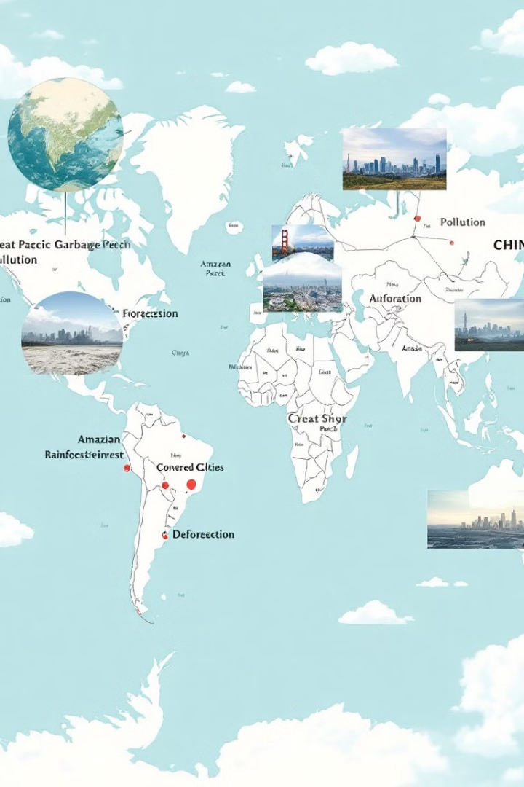
Global and Local Case Studies
Great Pacific Garbage Patch
Amazon Rainforest Deforestation
A vast accumulation of plastic waste in the Pacific Ocean, highlighting the global scale of plastic pollution.
The destruction of the Amazon rainforest due to logging, agriculture, and mining, contributing to climate change and biodiversity loss.
Smog in Chinese Cities
Severe air pollution in many Chinese cities, caused by industrial emissions and vehicle exhaust, impacting human health and visibility.

Slide 11


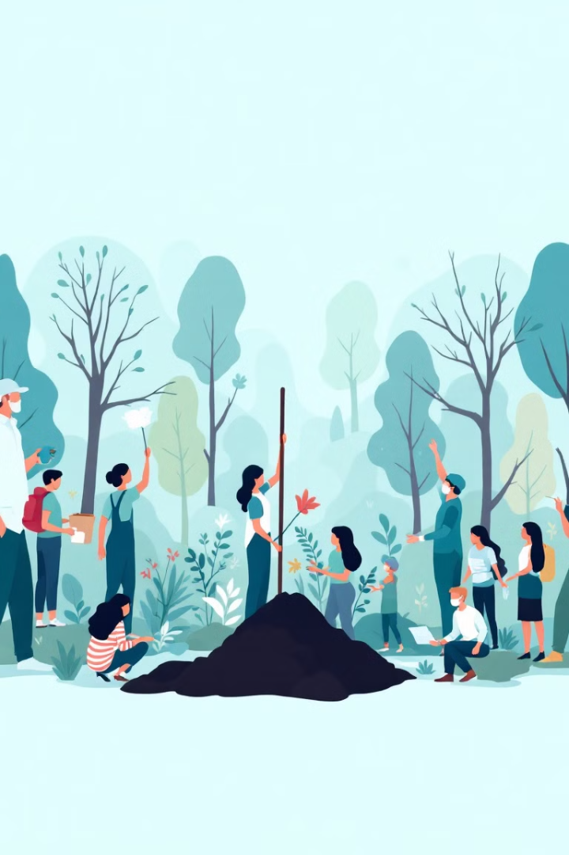


Addressing Pollution: A Call to Action
Sustainable Practices
Reduce, Reuse, Recycle
Adopting sustainable practices in all aspects of life, from energy consumption to waste management, is crucial.
Reducing consumption, reusing materials, and recycling waste are essential for minimizing pollution.
Government Regulations
International Cooperation
Strict regulations and policies are needed to hold polluters accountable and promote sustainable practices.
Collaboration between countries is essential for tackling pollution on a global scale.

Slide 12
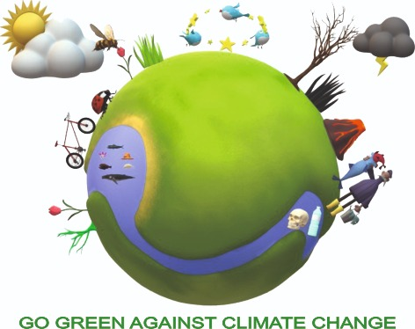
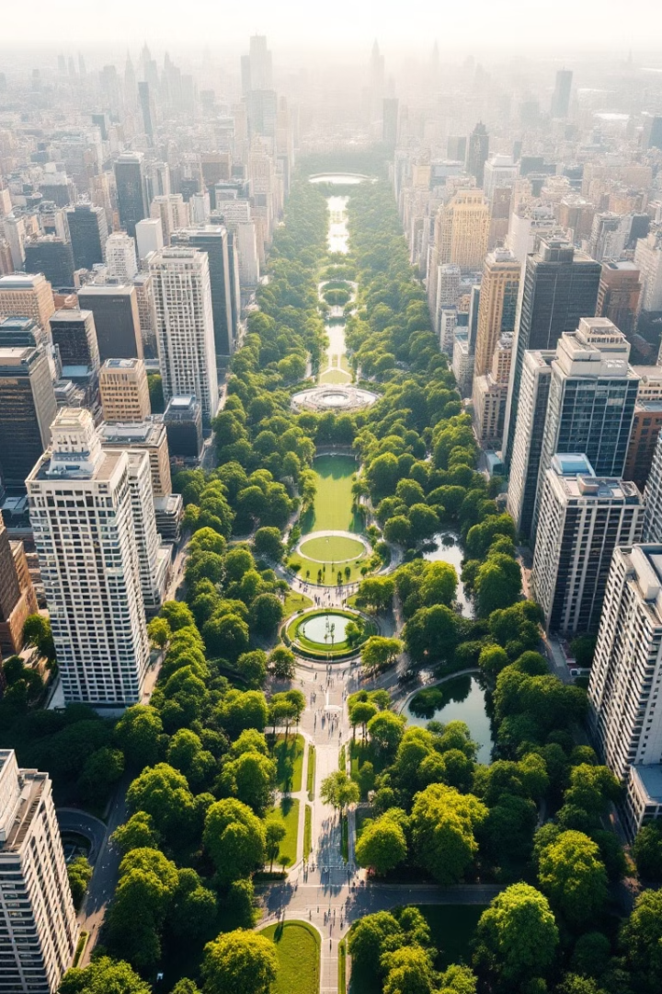
TOPIC 2: Waste Management, From Problem to Solution
We'll explore different types of waste, the importance of proper handling, various methods of dealing with it, and the ongoing global challenges and opportunities.
Go Green Against Climate Change - 2023-1-RO01-KA220-SCH-000161283

Slide 13
Types of Waste
Municipal Solid Waste
Industrial Waste
Hazardous Waste
E-Waste
Generated by factories, businesses, and manufacturing processes.
Includes toxic substances like chemicals, batteries, and medical waste, requiring special handling.
Discarded electronic devices such as phones, computers, and appliances, containing valuable materials and posing environmental risks.
Includes household trash, food scraps, packaging materials, and yard waste.
Go Green Against Climate Change - 2023-1-RO01-KA220-SCH-000161283

Slide 14
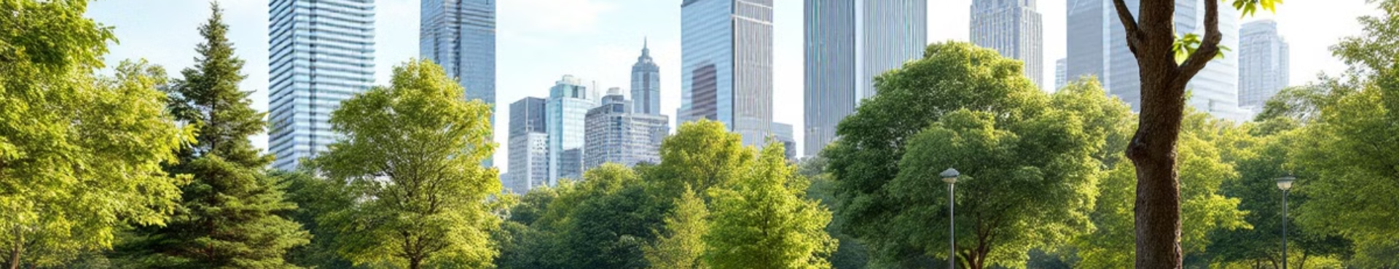
The Importance of Proper Waste Management
1
Environmental Protection
2
Public Health
Minimizes pollution, preserves natural resources, and protects ecosystems.
Reduces disease spread and ensures safe living conditions for communities.
3
Resource Conservation
4
Economic Benefits
Promotes recycling and reuse, extending the lifespan of valuable materials.
Creates jobs, fosters innovation, and drives a circular economy.
Go Green Against Climate Change - 2023-1-RO01-KA220-SCH-000161283

Slide 15
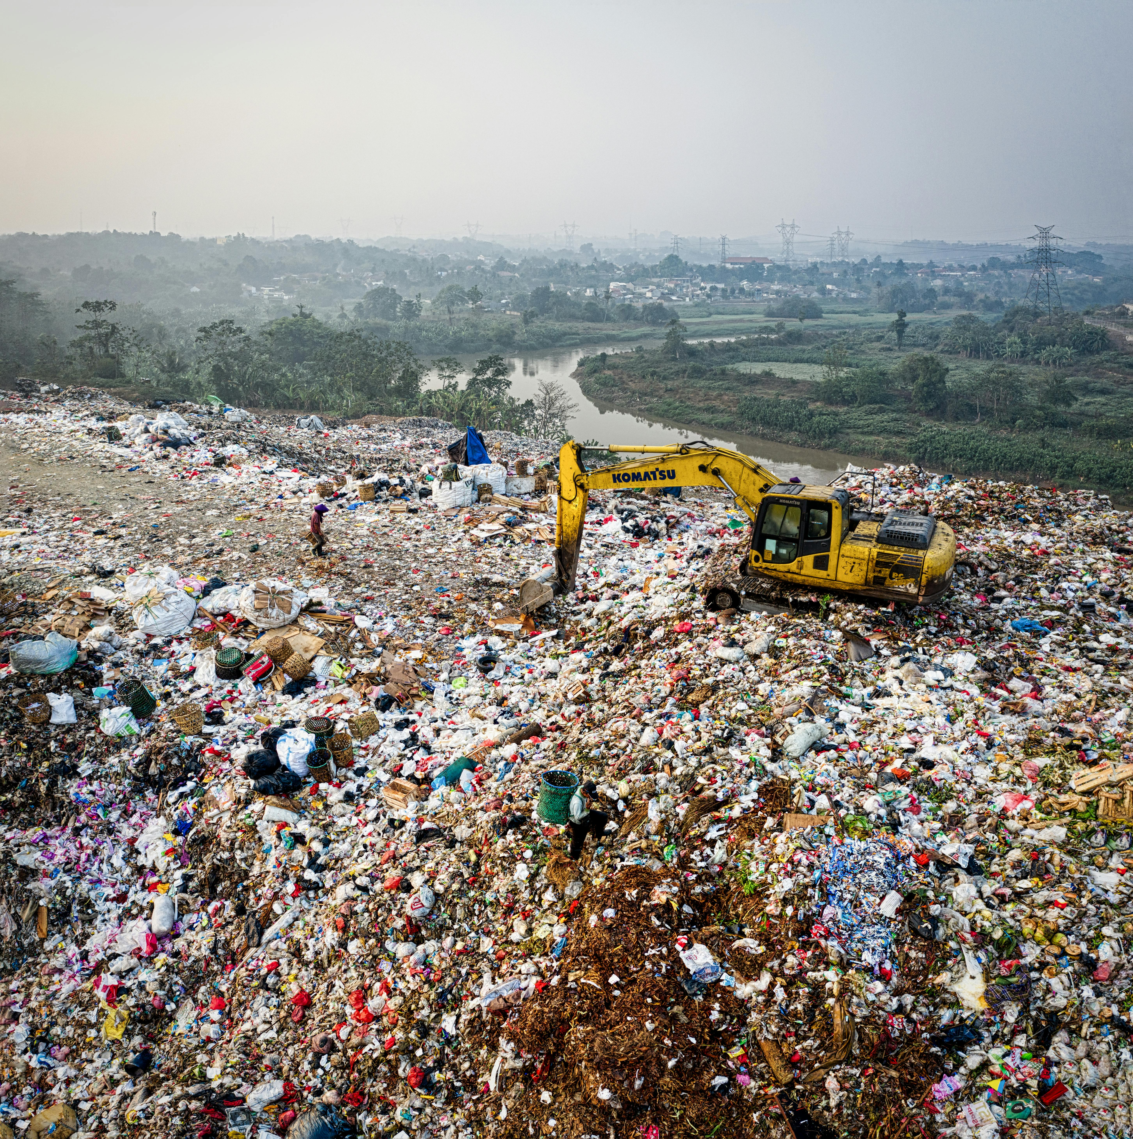
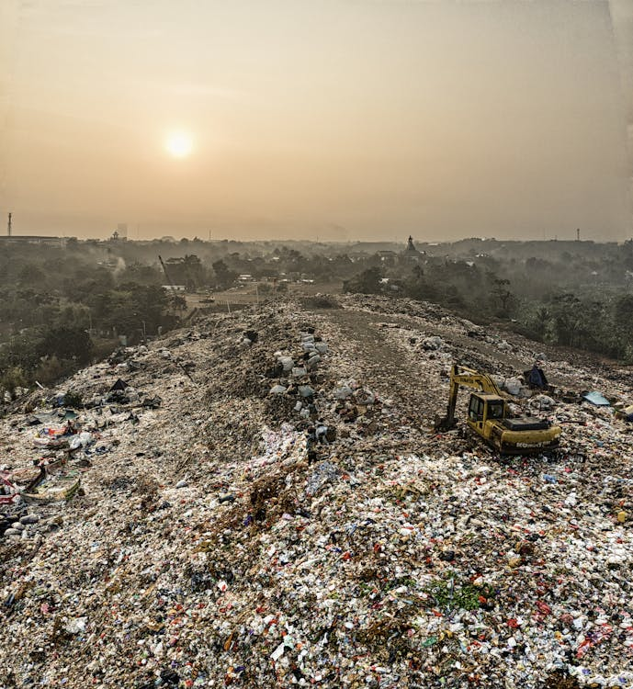
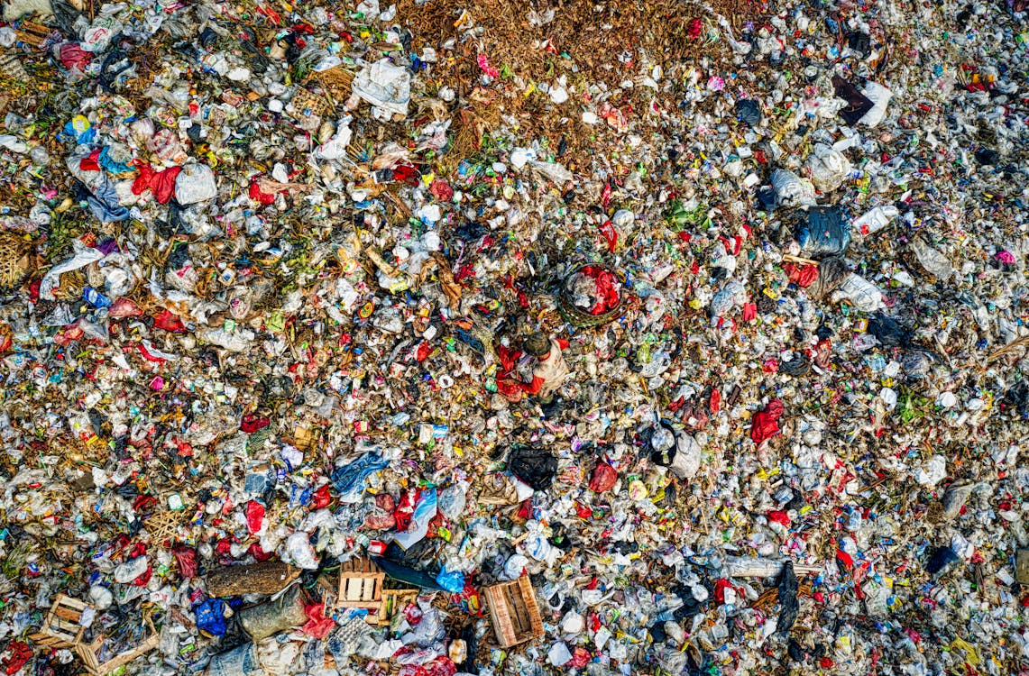
Landfills: Pros and Cons
Pros
Cons
Cost-effective, can handle large volumes of waste, and suitable for non-hazardous materials.
Take up valuable land, generate methane gas, and contribute to groundwater contamination.
Go Green Against Climate Change - 2023-1-RO01-KA220-SCH-000161283

Slide 16
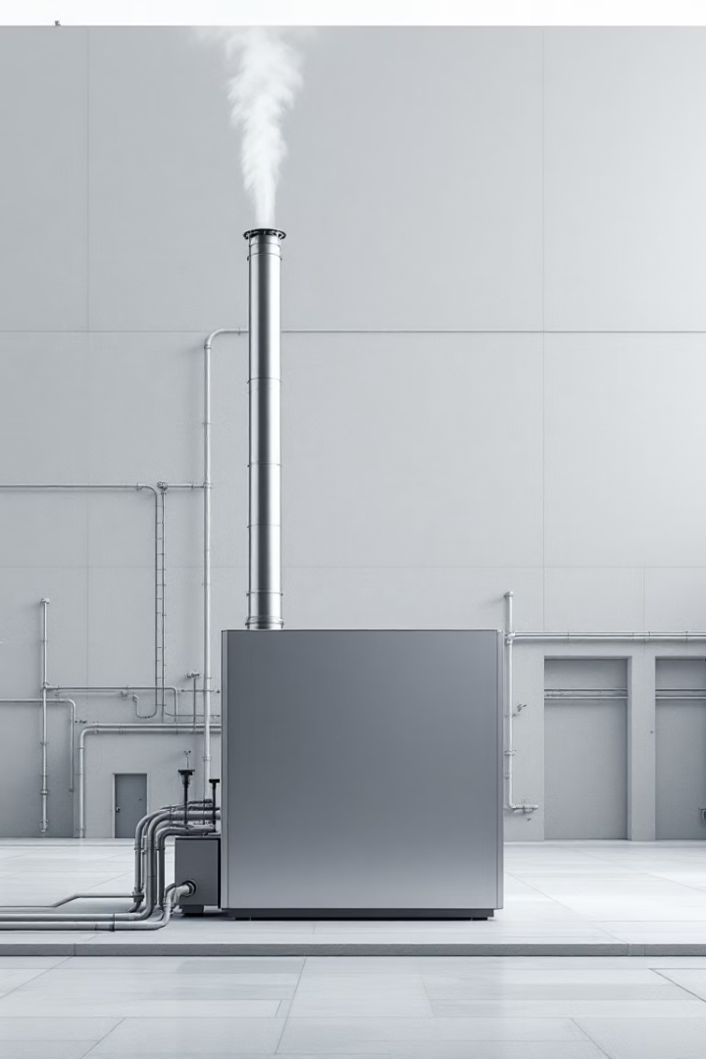


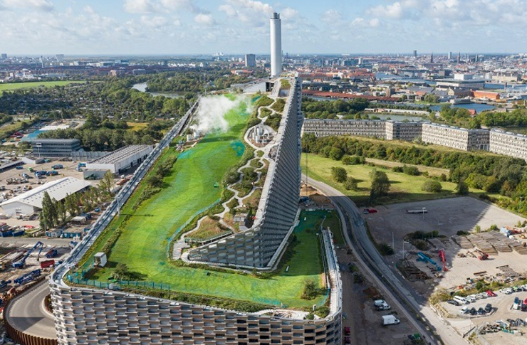

Incineration and Its Impact
Waste Reduction
Air Pollution
Reduces waste volume but generates ash and air pollution.
Releases harmful gases and particulate matter, impacting air quality.
Energy Recovery
Can generate heat and electricity but requires careful management of emissions.
Go Green Against Climate Change - 2023-1-RO01-KA220-SCH-000161283

Slide 17
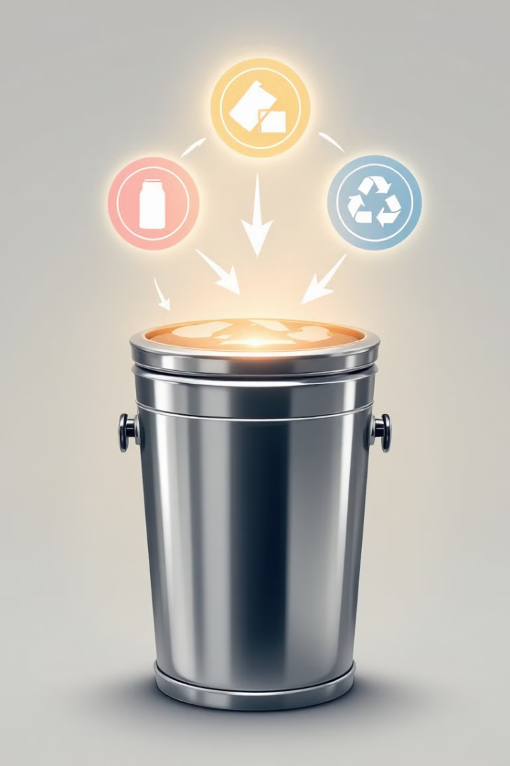
TOPIC 3: Recycling, a key solution
1
Collection
Separating recyclable materials from general waste.
2
Processing
Cleaning, sorting, and preparing materials for reuse.
3
Manufacturing
Turning recycled materials into new products.
Go Green Against Climate Change - 2023-1-RO01-KA220-SCH-000161283

Slide 18



Composting: Turning Waste into Resources
Food Scraps
Kitchen waste, like fruit peels and coffee grounds, can be composted.
Yard Waste
Grass clippings, leaves, and tree branches can be composted.
Compost
Rich, nutrient-rich soil amendment for gardening.
Go Green Against Climate Change - 2023-1-RO01-KA220-SCH-000161283

Slide 19





Challenges in Waste Management
Lack of Infrastructure
1
Limited facilities for collection, sorting, and processing.
2
Public Awareness
Educating and motivating people to participate in waste management.
3
Financial Constraints
Funding challenges for investing in sustainable waste management.
4
Technological Advancement
Developing innovative technologies for waste reduction and recycling.
5
Policy and Regulation
Implementing effective policies to encourage
Go Green Against Climate Change - 2023-1-RO01-KA220-SCH-000161283

Slide 20
Towards a Sustainable Future:
Reducing Waste
1
2
Reduce
Reuse
Consume less and choose products with minimal packaging.
Give items a second life through repurposing and donation.
3
4
Recycle
Compost
Properly sort and dispose of recyclable materials.
Turn food scraps and yard waste into valuable compost.
Go Green Against Climate Change - 2023-1-RO01-KA220-SCH-000161283

Slide 21

The Power of Recycling: A Guide
Go Green Against Climate Change - 2023-1-RO01-KA220-SCH-000161283

Slide 22
Benefits of Recycling
Environmental Impact
Economic Advantages
Recycling reduces landfill waste, conserves natural resources, and lowers greenhouse gas emissions.
Recycling creates jobs, stimulates local economies, and lowers the cost of raw materials.
Go Green Against Climate Change - 2023-1-RO01-KA220-SCH-000161283

Slide 23
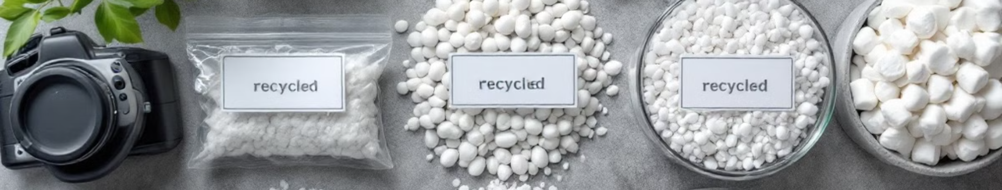
Commonly Recycled Materials
Paper & Cardboard
Plastic
Newspapers, magazines, cardboard boxes, and paperboard products.
Bottles, containers, and packaging materials.
Glass
Metal
Bottles, jars, and other glass containers.
Cans, aluminum foil, and scrap metal.
Go Green Against Climate Change - 2023-1-RO01-KA220-SCH-000161283

Slide 24
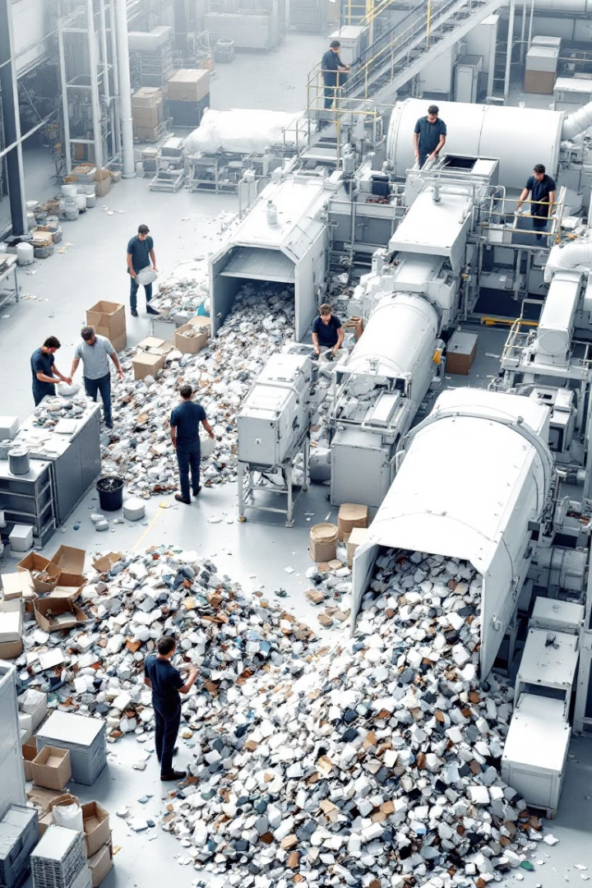



Challenges in Recycling
Contamination
Cost
Mixing recyclable materials with non-recyclable items hinders the process.
Recycling can be expensive, and funding can be limited.
Demand
Not all recycled materials have a high demand, leading to stockpiles.
Go Green Against Climate Change - 2023-1-RO01-KA220-SCH-000161283

Slide 25
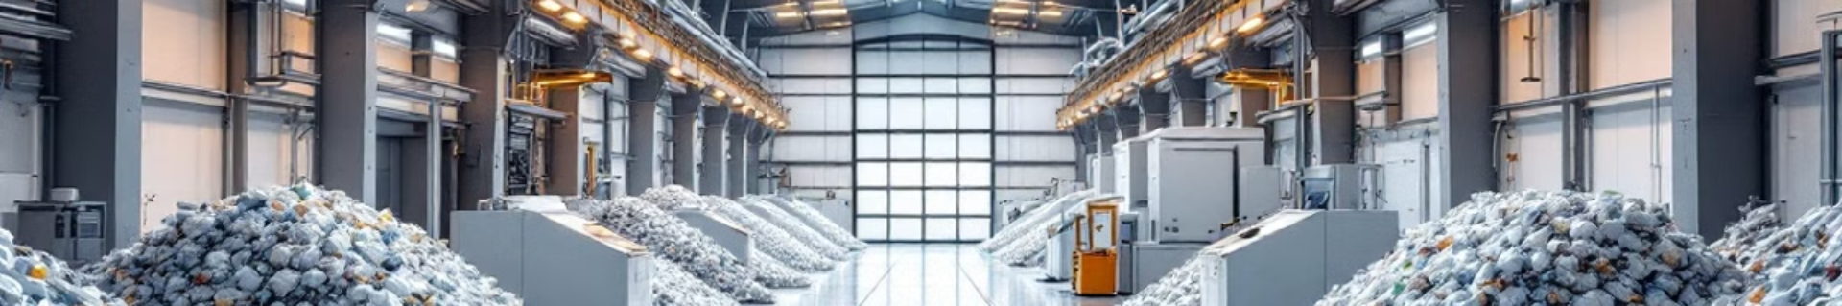
Innovations and Success Stories
Advanced Sorting Technologies
Green Building Materials
AI-powered sorting systems can identify and separate materials with high accuracy.
Sustainable building materials made from recycled materials, reducing reliance on virgin materials.
1
2
3
Closed-Loop Recycling
Recycling processes that utilize recycled materials to produce new products.
Go Green Against Climate Change - 2023-1-RO01-KA220-SCH-000161283

Slide 26
Test yourself! Fill out the questionnaire!
https://docs.google.com/forms/d/1AiKYJgBxecWhntTP8KzWYyGiPV6wyzi1cKu21l4SrEw/viewform?edit_requested=true

Slide 27


