Slide 1


GO GREEN AGAINST CLIMATE CHANGE
2023-1-RO01-KA220-SCH-000161283
GO GREEN AGAINST CLIMATE CHANGE
2023-1-RO01-KA220-SCH-000161283

Slide 2
1. Introduction
Definition of natural disasters
Turkey’s geographical location and high disaster risk
GO GREEN AGAINST CLIMATE CHANGE
2023-1-RO01-KA220-SCH-000161283

Slide 3
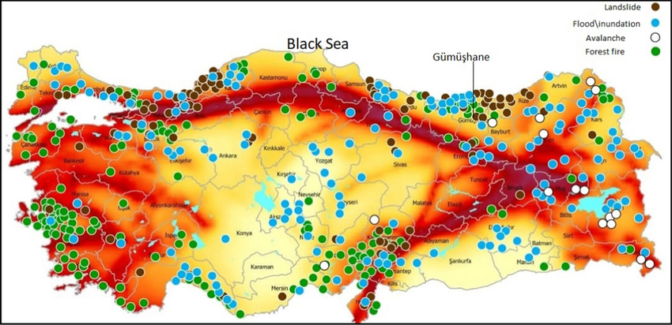
1. Introduction
Definition of natural disasters
Turkey’s geographical location and high disaster risk
GO GREEN AGAINST CLIMATE CHANGE
2023-1-RO01-KA220-SCH-000161283

Slide 4
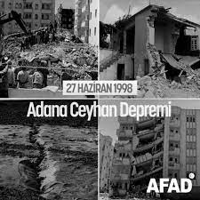
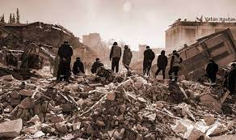
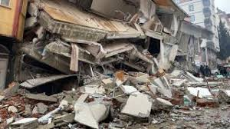
2. Major Natural Disasters in Türkiye
Earthquakes
Fault lınes: North Anatolıan, East Anatolıan, Western Anatolıa
Major earthquakes: 1999 Marmara, 2023 Kahramanmaraş
Socıal and economıc ımpacts
GO GREEN AGAINST CLIMATE CHANGE
2023-1-RO01-KA220-SCH-000161283

Slide 5
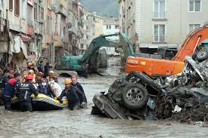
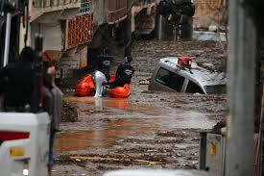
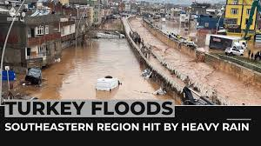
Floods
Common in the Black Sea Region
Causes: heavy rainfall, unplanned urbanization
Recent flood events
GO GREEN AGAINST CLIMATE CHANGE
2023-1-RO01-KA220-SCH-000161283

Slide 6
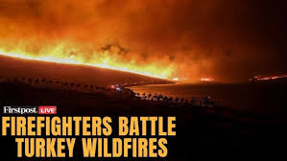
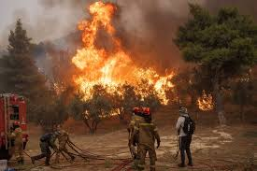
Wıldfıres
Mostly in the Mediterranean and Aegean Regions
Example: 2021 Antalya and Muğla fires
Climate change effects
GO GREEN AGAINST CLIMATE CHANGE
2023-1-RO01-KA220-SCH-000161283

Slide 7
Impacts of Natural Dısasters
Human losses and ınjurıes
Economıc damages
Envıronmental destructıon
Mıgratıon and psychologıcal ımpacts
GO GREEN AGAINST CLIMATE CHANGE
2023-1-RO01-KA220-SCH-000161283

Slide 8
4. Disaster Management and Preparedness
Role of AFAD (Disaster and Emergency Management Authority) and Turkish Red Crescent
Early warning systems
Earthquake and fire drills in schools and workplaces
Sustainable urban planning and public education
GO GREEN AGAINST CLIMATE CHANGE
2023-1-RO01-KA220-SCH-000161283

Slide 9
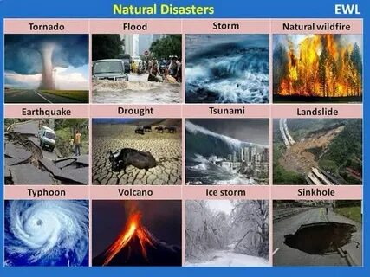
Conclusıon
The importance of disaster preparedness
Strengthening community resilience
Living in harmony with nature
GO GREEN AGAINST CLIMATE CHANGE
2023-1-RO01-KA220-SCH-000161283

